Slide 2

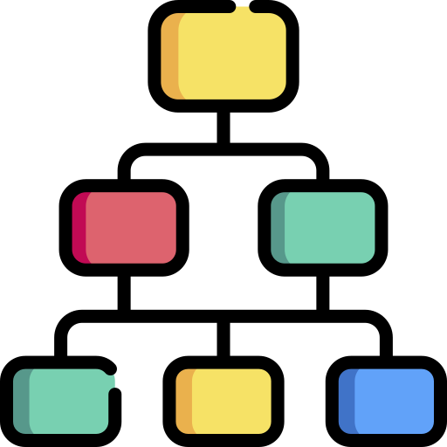







Literature review of gender and feminist theories
Taxonomy with corresponding list of keywords
Subreddit data extraction using static keyword matching
Semantic similarity: Women software developer experiences
List of action items
Model validation by EDI lab experts
Semantic similarity: taxonomy definitions

